Slide 1

E-commerce Xyz Corp Business Analysis
By Allen Lu

Slide 2
Background
Over half million transactions
The largest E-commerce site in a developing country
Fields/Columns of Data: category, order status, price, sku, orderID, itemID, date, qty_ordered, discount
The Purpose of this Analysis: identify order cancelation patterns and recommendations on how to reduce order cancelation rate
Data Source:
https://www.kaggle.com/zusmani/pakistans-largest-ecommerce-dataset

Slide 3
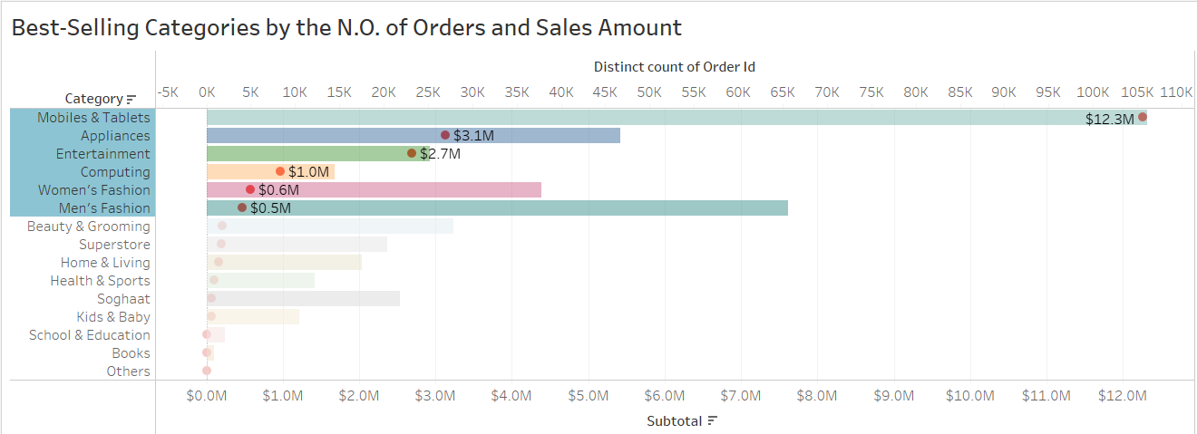
Electronics: the Best-Selling Categories
Order Amount

Slide 4
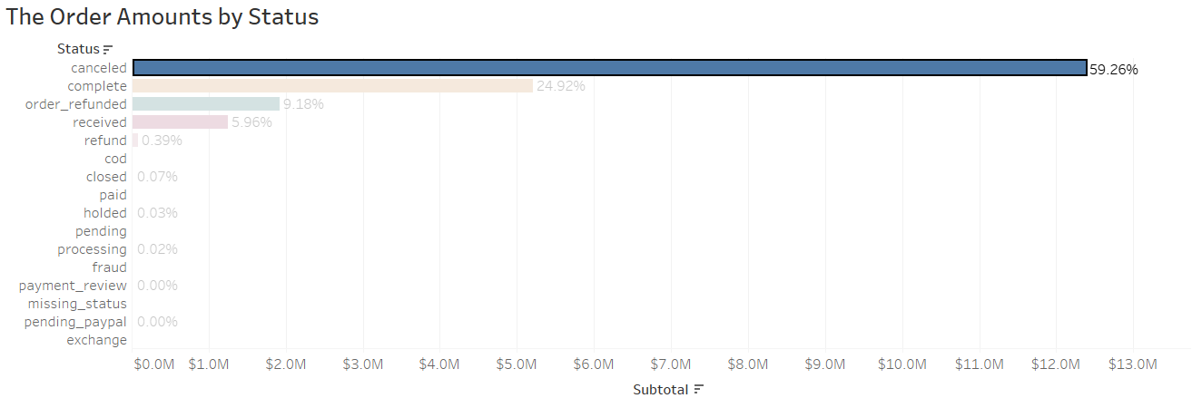
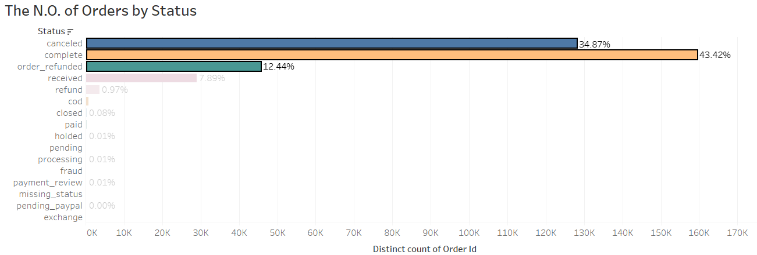
Canceled Order Amount much higher than Complete ones

Slide 5
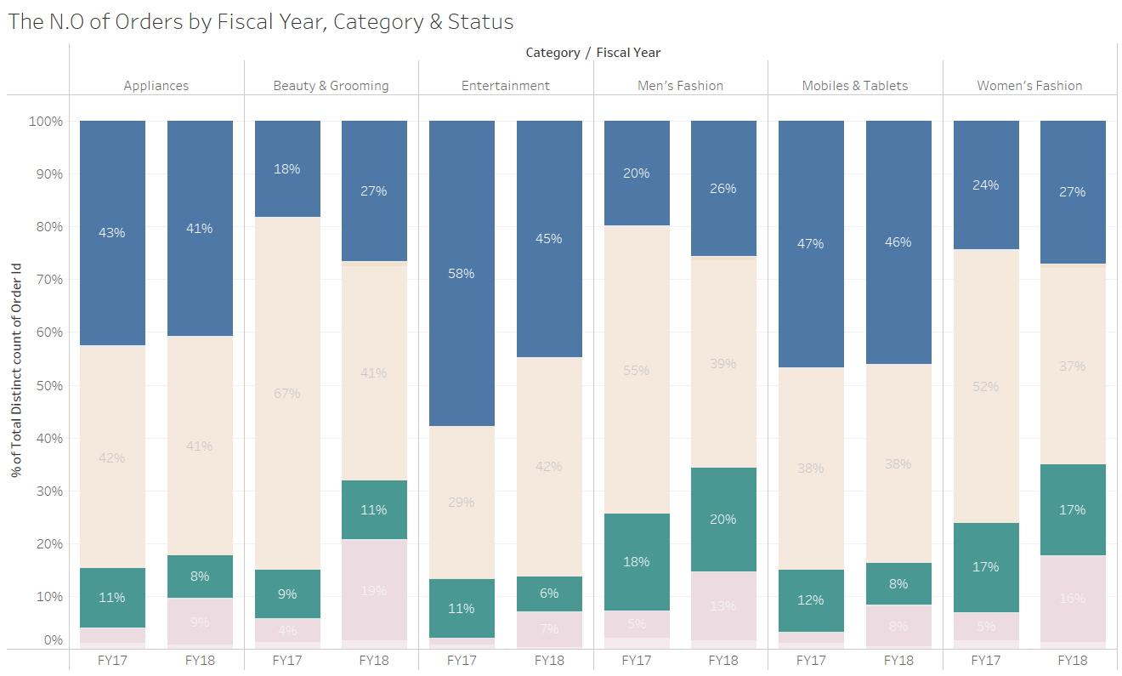
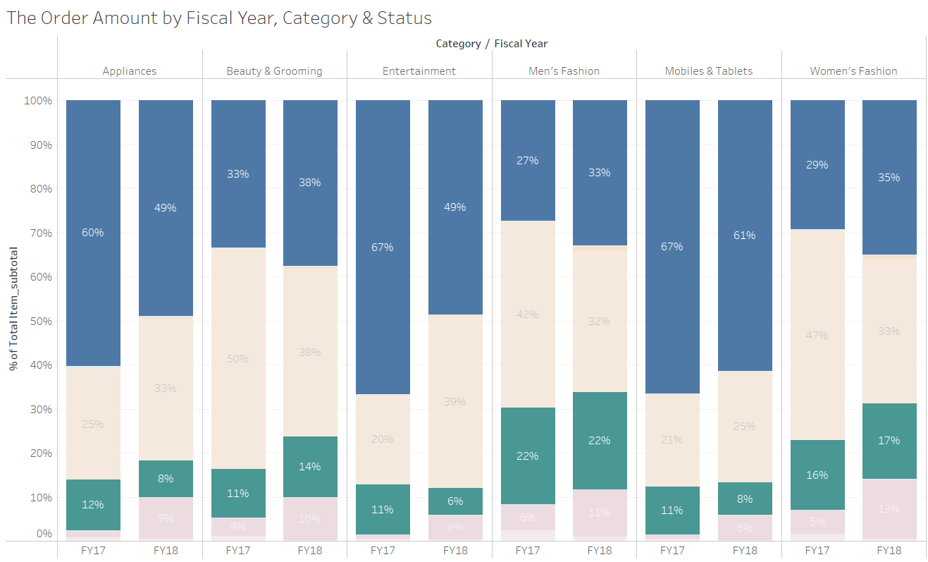
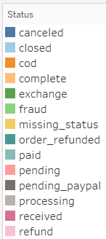
The More Expensive Items are more likely to be Returned

Slide 6
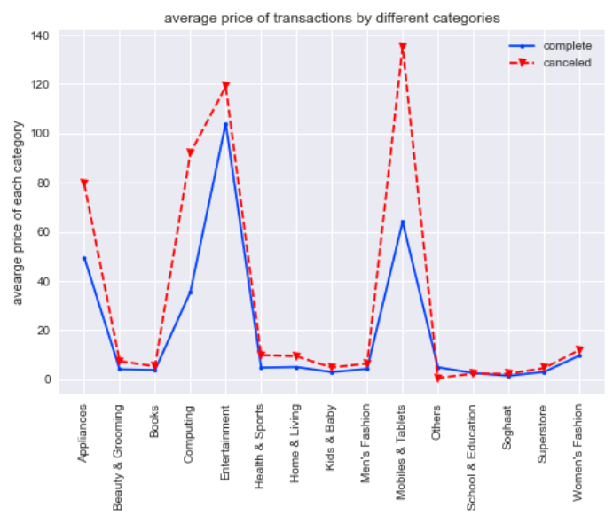
Average Prices of Cancelation items in Mobile & Tablets, Computing, Appliances, Entertainment Categories are significantly higher

Slide 7
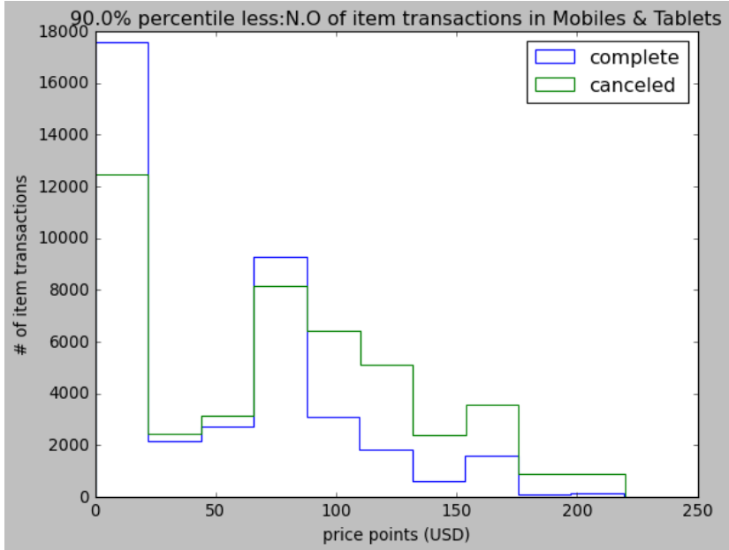
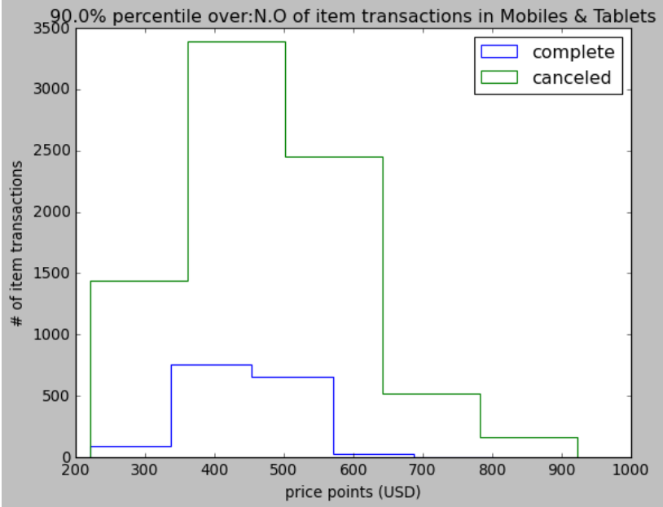
$80 USD, the turning point in Mobiles & Tablets Category

Slide 8
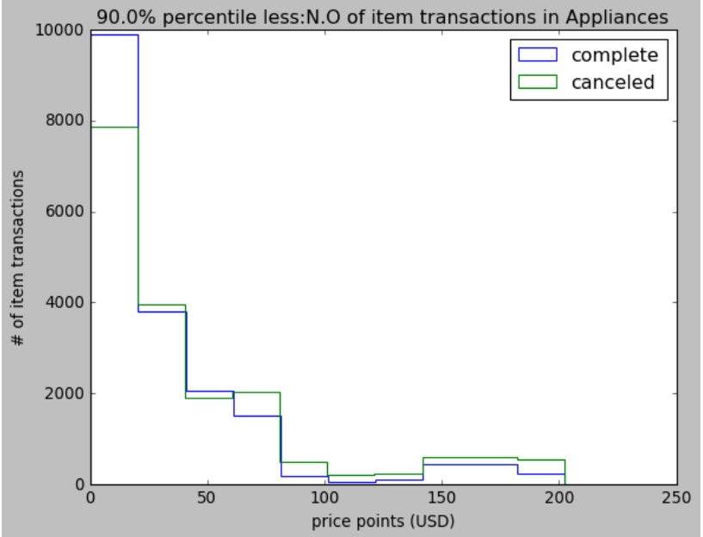
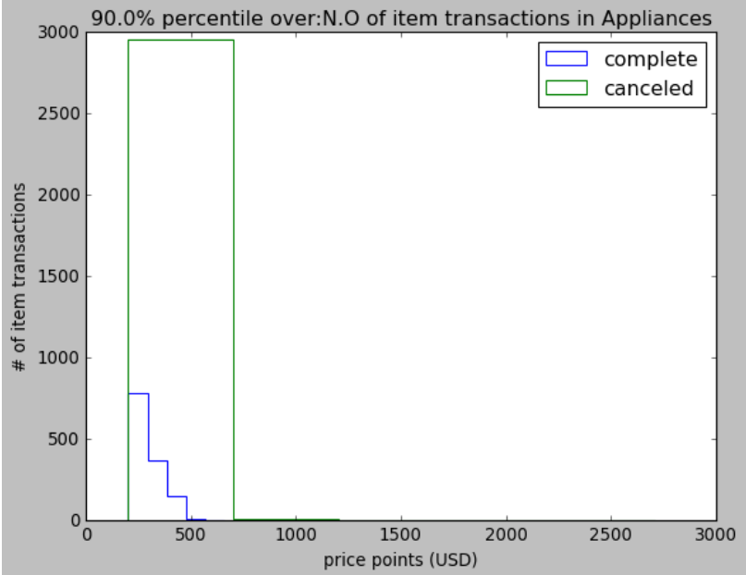
Over $200 USD, Customers getting “pickier” in Appliances

Slide 9
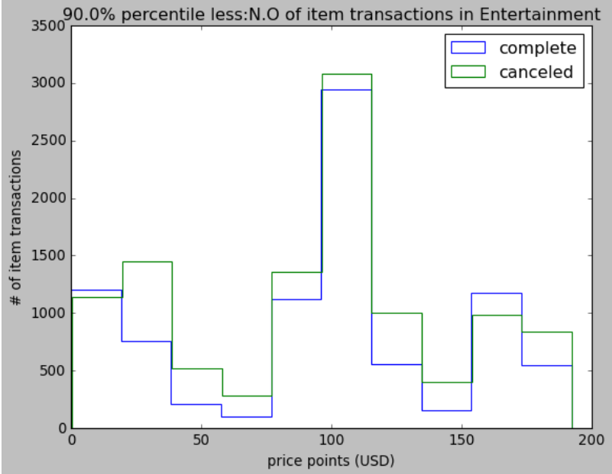
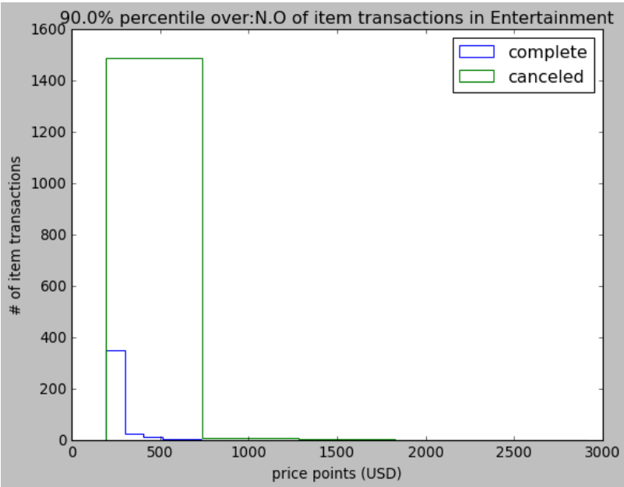
Similar Pattern in Entertainment Category

Slide 10
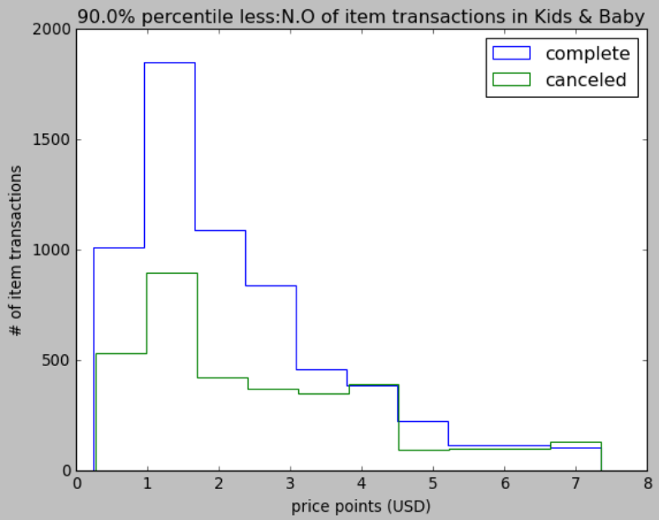
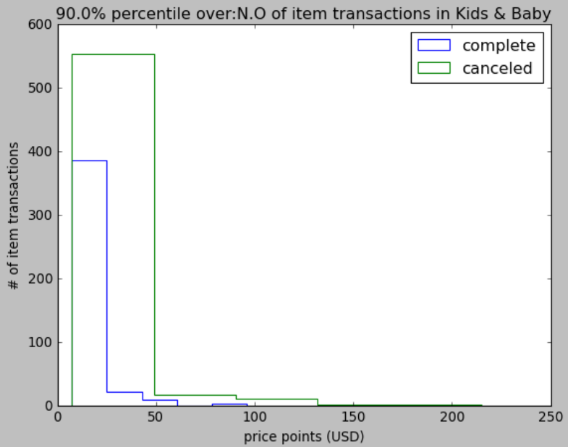
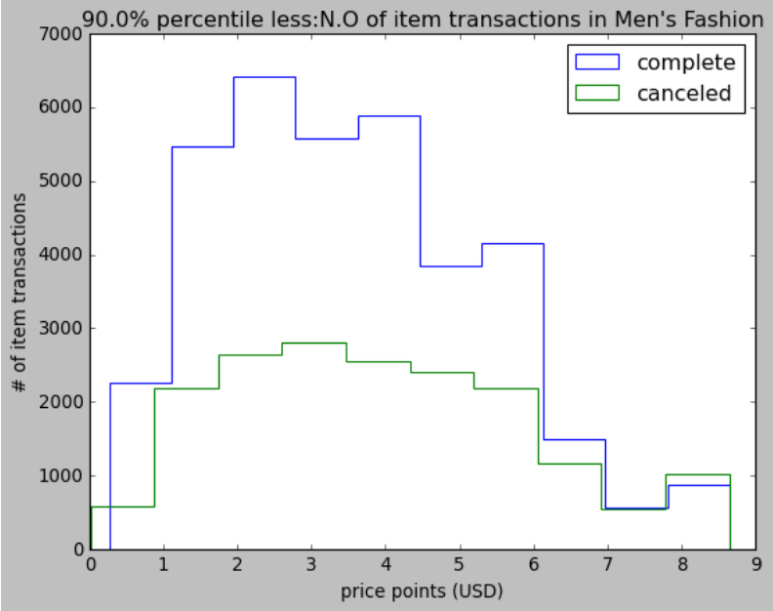
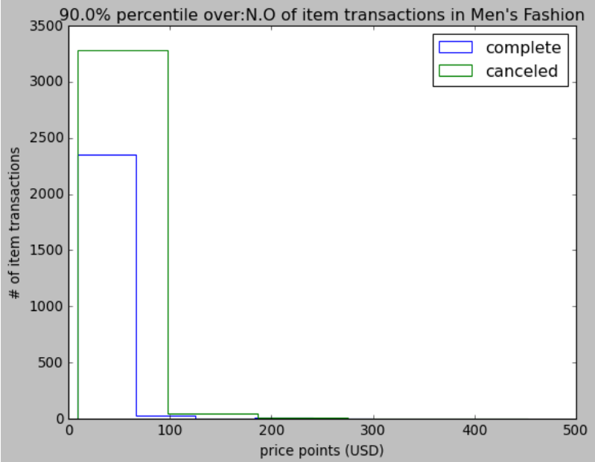
The Pattern persists in less-expensive categories when items get relatively pricy

Slide 11

Recommendations
Do due diligence on customer before high-vale item transactions
Establish customer/buyer review and credit rating system (share across platforms)
Token deposit for expensive items (deposit will be refunded if order not canceled)
Remove COD payment option for expensive items
Improve high-value listing qualities
Local distribution, demonstration, and logistics in business hubs

Slide 12
Appendix Pages

Slide 13
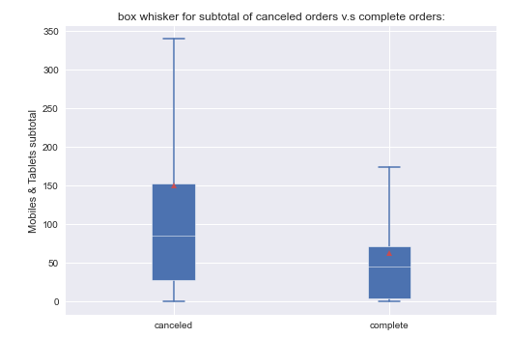
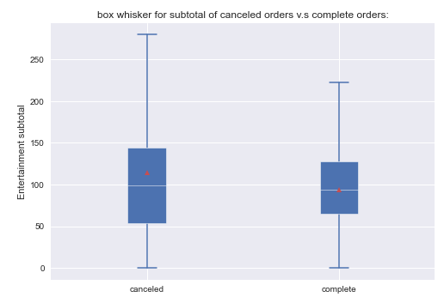
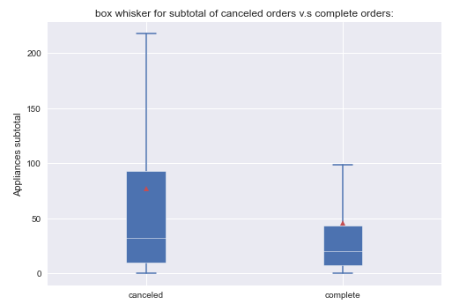
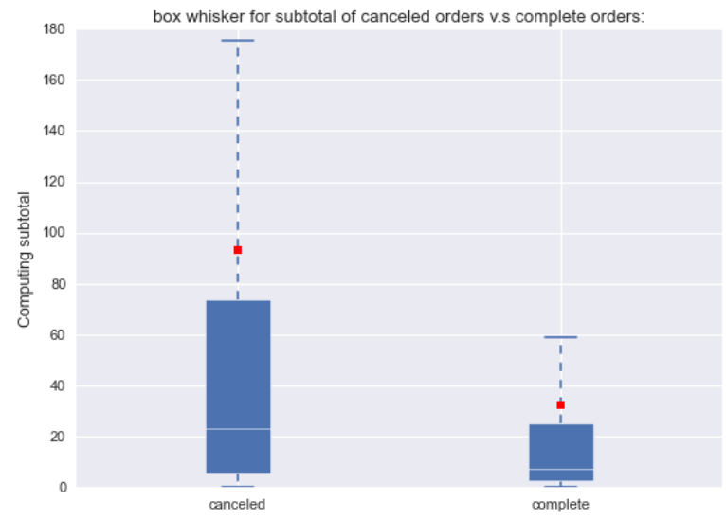
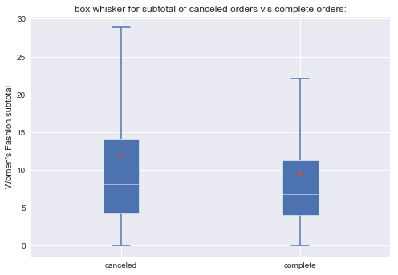
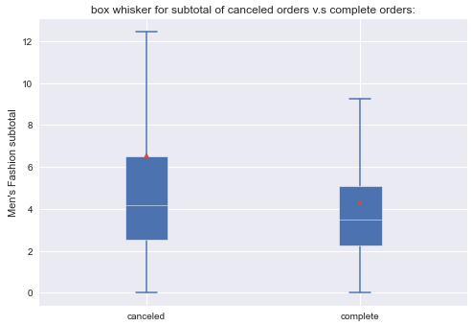
Computer, Mobile & Tablets Merchants Suffer the Most

Slide 14
Cash-on-Delivery (COD): Pros & Cons
Reasons
Lack of awareness and infrastructure for online Payment
Limited access to smartphone, tablet, and online bank accounts
Pros of COD
No risk of money loss (seller default or late)
Sense of security (validate product before payment)
No dependency on payment cards
No payment frauds
Flexible Payment options
Cons of COD
Vulnerable to losses (return without payment or frauds)
Additional business costs (courier expense)
Notes:
According to Nielsen’s Global Connected Commerce Survey (Business Insider), 83% of consumers in India preferred using COD as a payment mode for online purchase;

Slide 15
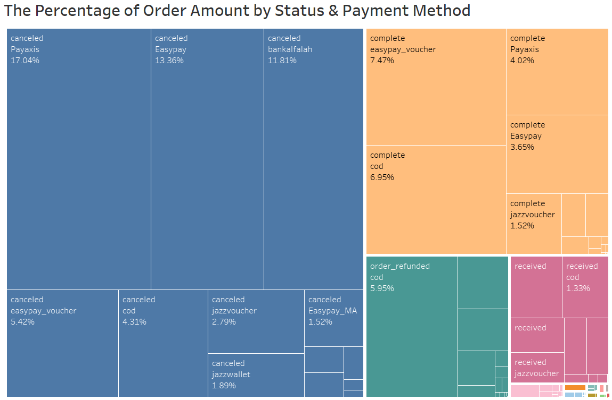
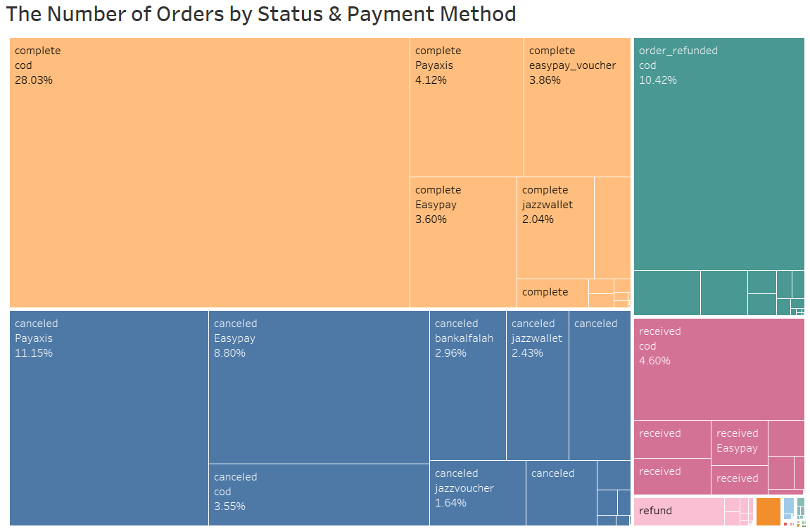
Canceled Orders almost as many as Completed Ones

Slide 16
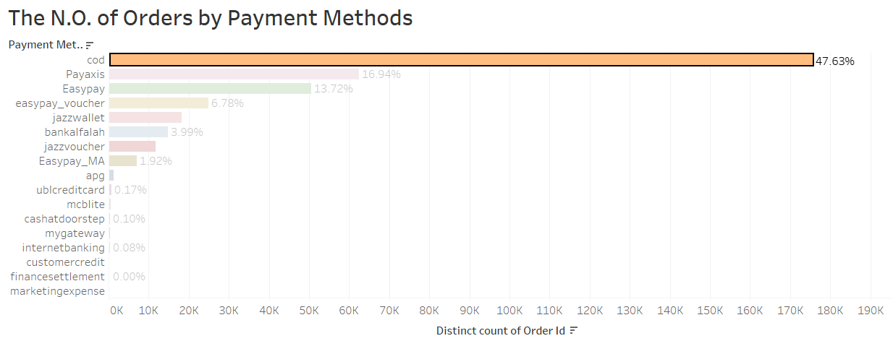
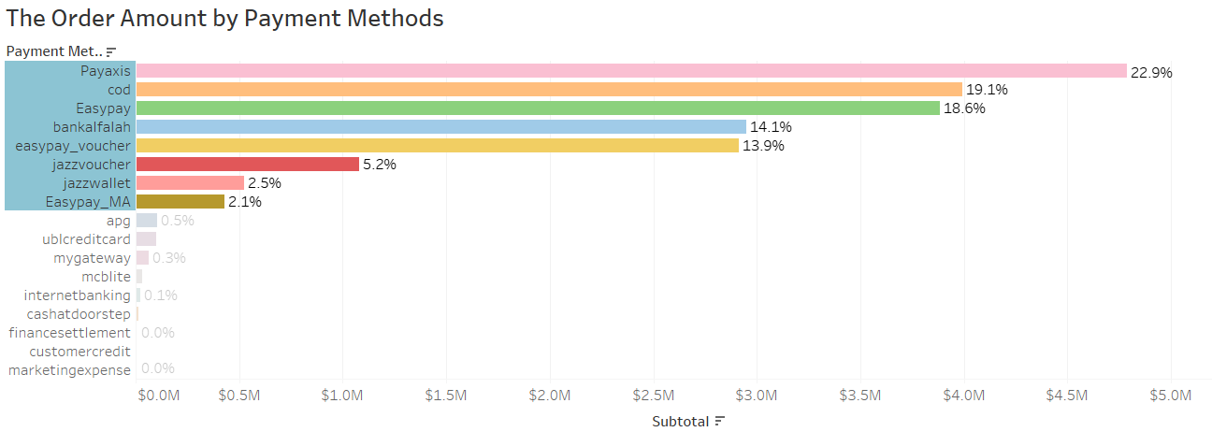
COD is the most widely used payment method, While Payaxis the most popular for high-value transactions

Slide 17
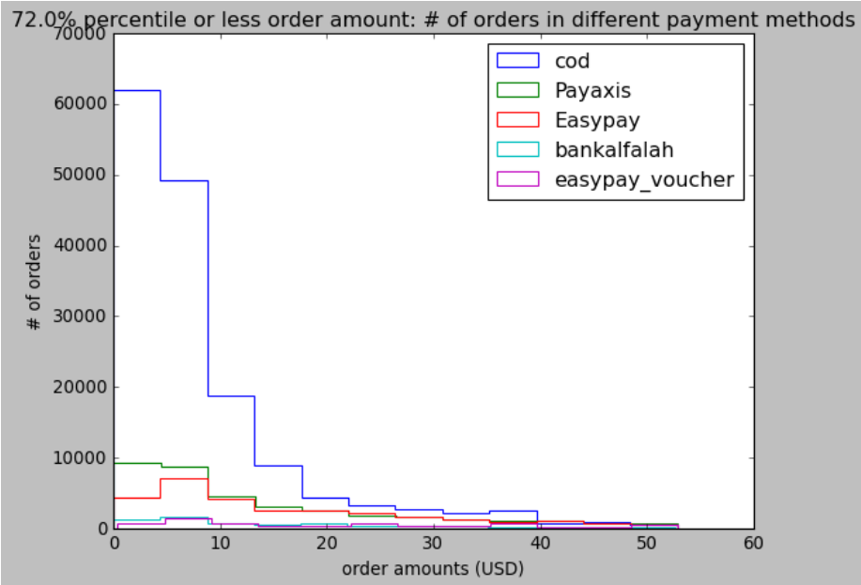
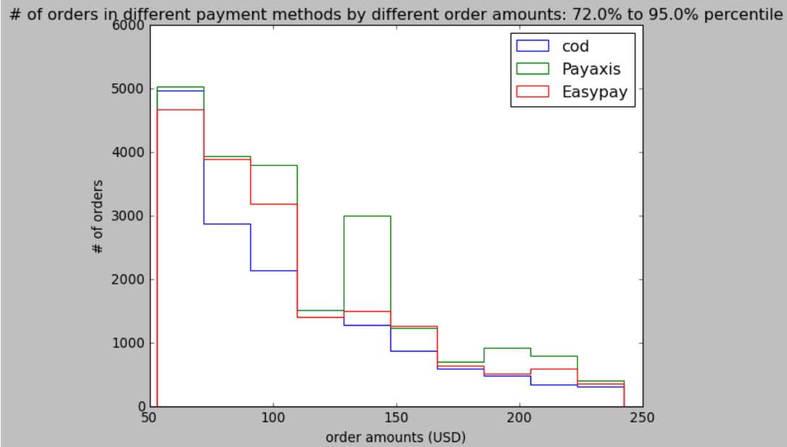
From around $40 USD, Payaxis and Easypay Took over the Lead

Slide 18
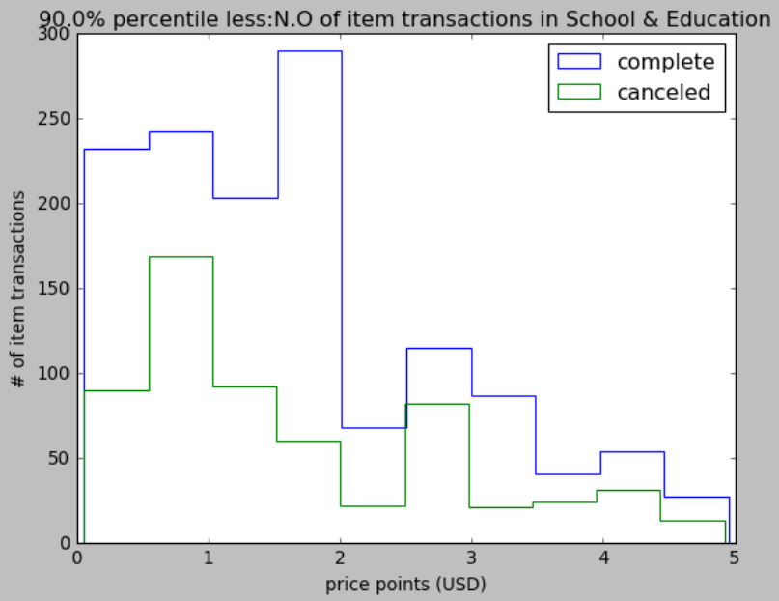
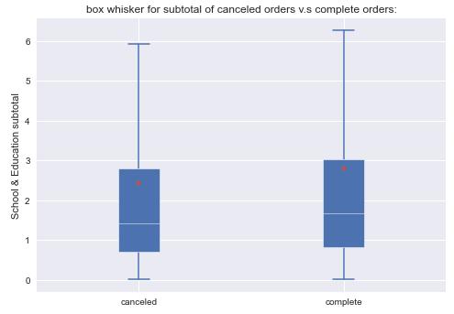
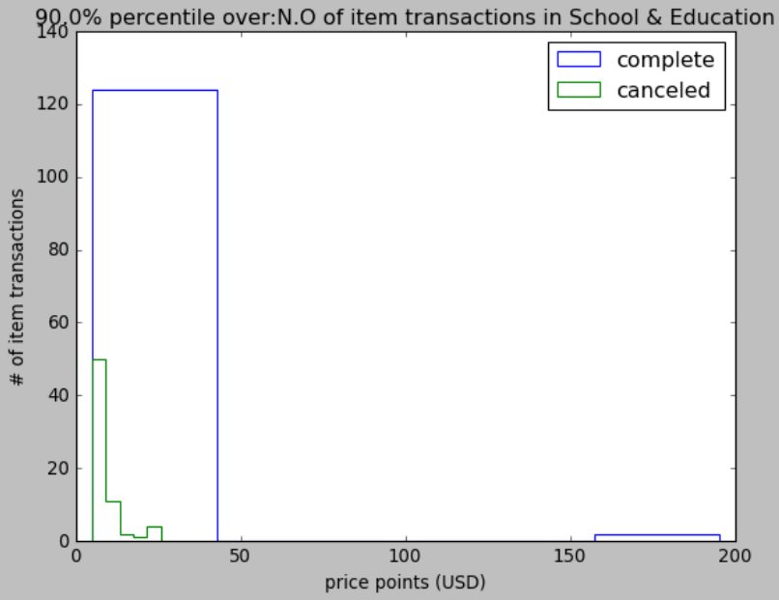
Exception: School & Education Category

